Slide 1
SECSI FRA
Benefits for Airspace Users
WAC Madrid, 7 March 2018 Davor Mizerit, Slovenia Control

Slide 2
S
E
C
S
I

Slide 3
NO DCT LIMIT
UNKEN
LATLO
OBEDI
NO POINTs LIMIT
S
ELKAT
eam
l
ess
KFT
PODET
ZAG
LURID
DOBOT
VEBAR
ODLET
…2018
…2016
…2014
VABEK

Slide 4
S
E
C
S
I

Slide 5
+ 35%
98,5%
- 10 NM
volume
traffic
s. flights
E
C
S
x
t
r
a
.V..
SAXFRA
SECSI FRA
SEAFRA
I
FL660
FL325
FL315
FL305
FL295
FL285
FL275
FL265
FL255
FL245
FL235
FL205
FL215
FL225

Slide 6
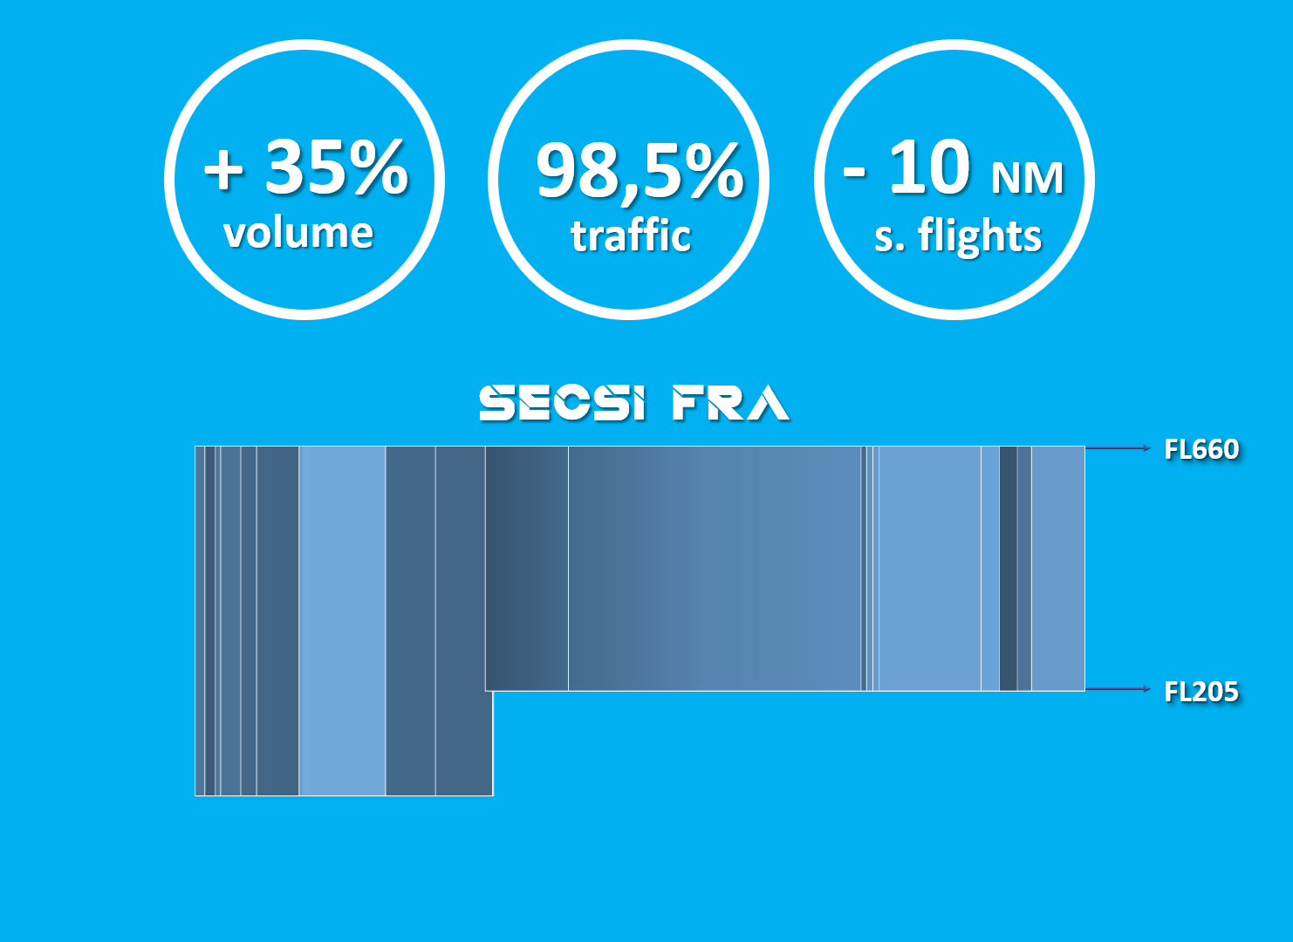
S
E
C
S
I

Slide 7
20
domestic
SECSI FRA
C
o
nne
c
t
11
DCT
DCT
DCT
Internat.
A
X
D
1100+
flights

Slide 8
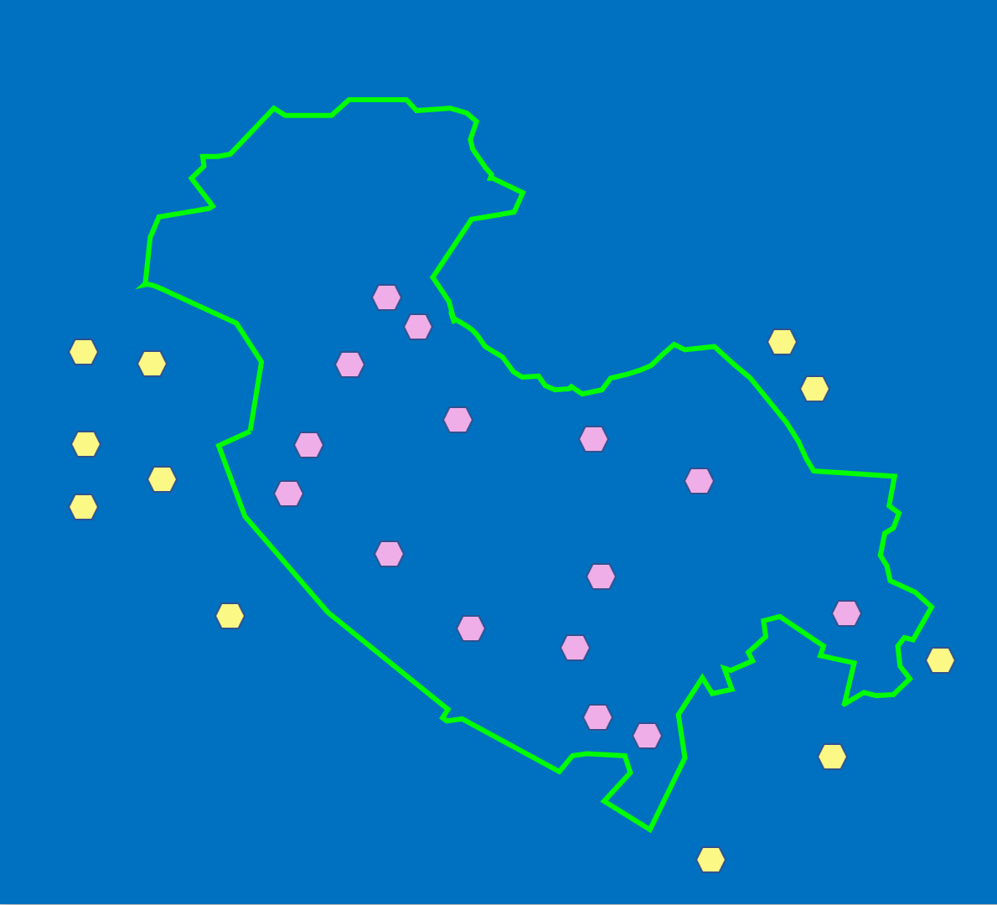
S
E
C
S
I

Slide 9
PROCEDURES
DATABASE
S
i
m
p
l
e
AVAILABILITY
PUBLICATION

Slide 10
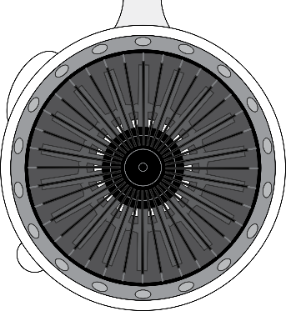
S
E
C
S
I
ANSP
ATM
exp
ECTL
NM
NSA
n
v
o
l
v
e

Slide 11
THANK YOU
- 25500 kg/day CO2
- 84 kg/day NOx
- 1900 NM day
- 280 min day
- 8000 kgs day
SECSI Team
Davor Mizerit

